Slide 1

Department of Computer Science and Engineering
(Cyber Security)
CS23533– Foundations of Artificial Intelligence
2026-2027
Intelligent University Timetable Generator
— REVIEW 2
Dr. S. Bhuvana
Assistant Professor[SG]
Ponsurabhi.V 241901077
Swarnamala.V 241901116

Slide 2
Problem Statement and Motivation
Problem Statement
University timetable generation involves assigning subjects, faculty members, classrooms, laboratories, and periods without conflicts.
Manual scheduling is time-consuming and prone to errors.
Faculty unavailability can disrupt an existing timetable and require several changes.
Conventional timetable generation may require regenerating the entire timetable even when only a few classes are affected.

Slide 3
Problem Statement and Motivation
Motivation:
Automate timetable generation using classical Artificial Intelligence techniques.
Reduce faculty, classroom, and section conflicts.
Adapt to faculty leave while preserving unaffected timetable assignments.
Improve scheduling efficiency, consistency, and maintainability.
Problem Addressed
How can a university timetable be generated automatically and adapted to changes using CSP while minimizing unnecessary changes to the existing schedule?

Slide 4
Objectives
Primary Objectives:
Develop an automated university timetable generator using Constraint Satisfaction Problems.
Model class sessions, time slots, faculty, sections, rooms, and laboratories as CSP variables and constraints.
Implement Backtracking Search to find valid timetable assignments.
Apply Minimum Remaining Values (MRV), Least Constraining Value (LCV), and Forward Checking to improve search efficiency.
Develop an adaptive rescheduling mechanism for faculty leave.
Preserve unaffected timetable assignments whenever possible.

Slide 5
Objectives
Expected Outcomes:
Conflict-free timetable generation.
Automatic identification of affected classes.
Reduced unnecessary timetable modifications.
Role-based access for administrators, faculty, and students.
Evaluation using execution time, search nodes, backtracks, constraint checks, and timetable stability.
Current Status
Core timetable generation, role-based interfaces, and the adaptive rescheduling demonstration have been implemented.

Slide 6
Project Progress Since Review 1
Work Completed
Analysed university timetable scheduling requirements.
Identified hard constraints and scheduling preferences.
Designed the CSP-based scheduling model.
Implemented Backtracking Search for timetable generation.
Incorporated MRV and Forward Checking into the search process.
Developed a Flask-based web interface.
Integrated SQLite for storing timetable-related information.

Slide 7
Project Progress Since Review 1
Implemented administrator, faculty, and student interfaces.
Developed faculty leave request and approval workflows.
Implemented adaptive rescheduling for affected classes.
Tested timetable display, laboratory blocks, and rescheduling behaviour.

Slide 8
Project Progress Since Review 1
Component | Status
CSP formulation | Completed
Timetable generation | Implemented
Web interface | Implemented
Database integration | Implemented
Faculty leave workflow | Implemented
Adaptive rescheduling | Demonstrated
Algorithm comparison | Under evaluation
Final Documentation | Pending

Slide 9
Literature Survey
S. No. | Author(s) & Year | Paper Title | Methodology / Algorithm | Limitations
1 | Lixi Zhang and Sim Kim Lau, 2005 | Constructing University Timetable Using Constraint Satisfaction Programming Approach | University Timetable Using Constraint Satisfaction Programming Approach | Provides a CSP-based scheduling foundation; adaptive rescheduling with minimal timetable changes is the focus of our extension.
2 | Burke et al., 2004 | The State of the Art of University Timetabling | Survey of university timetabling approaches and optimization techniques | Timetabling approaches and optimization techniques
3 | Dechter, 2003 | Constraint Processing | CSP representation, constraint propagation, and search techniques | Provides general CSP methods; their application to our specific university scheduling and adaptive rescheduling requirements must be implemented and evaluated.

Slide 10
Literature Survey
S. No. | Author(s) & Year | Paper Title | Methodology / Algorithm | Limitations
4 | Russell and Norvig, 2021 | Artificial Intelligence: A Modern Approach | CSP, Backtracking Search, MRV, LCV, and constraint propagation | Provides the theoretical foundation for the implemented classical AI algorithms.
5 | Schaerf, 1999 | A Survey of Automated Timetabling | Review of automated timetabling methods and scheduling approaches | Establishes the challenges and constraints involved in automated timetable generation

Slide 11
Research Gap and Project Response
Literature findings
CSP is suitable for problems involving variables, domains, and constraints.
Backtracking Search can systematically explore possible assignments.
MRV and constraint propagation can reduce unnecessary search.
University timetabling requires coordination of faculty, rooms, sections, and time slots.
2. Limitations
Timetable changes caused by faculty unavailability may affect multiple assignments.
Regenerating the entire timetable can unnecessarily disturb unaffected classes.
There is an opportunity to combine CSP-based scheduling with selective rescheduling.

Slide 12
Research Gap and Project Response
3. Refined research gap
Minimizing unnecessary changes during timetable adaptation while satisfying the affected classes' scheduling constraints.
4. Progress toward the solution
Identify the classes affected by faculty leave. Check whether a suitable substitute is available. If substitution is unsuitable or unavailable, reschedule the affected class using CSP. Preserve unaffected timetable assignments. Calculate a timetable stability index to measure schedule preservation.

Slide 13
System Architecture / Proposed System
Architecture Components
1. User Interface
Administrator dashboard.
Faculty dashboard.
Student timetable view.
Leave request and approval forms.
2. Timetable Management Module
Manage departments, sections, subjects, faculty, and rooms.
Configure availability and scheduling constraints.
Initiate timetable generation.

Slide 14
System Architecture / Proposed System
3. CSP Solver
Variables: class sessions.
Domains: valid day–period–room combinations.
Constraints: faculty, section, room, and laboratory requirements.
Algorithms: Backtracking Search, MRV, LCV, and Forward Checking.
4. Database
SQLite stores timetable-related information, including faculty, rooms, constraints, timetable assignments, and leave records.

Slide 15
System Architecture / Proposed System
5. Adaptive Rescheduling Module
Identifies affected assignments.
Checks substitute availability.
Invokes CSP-based rescheduling when required.
Preserves unaffected assignments where possible.
6. Output Module
Displays department-wise, section-wise, and faculty-wise timetables.
Displays updated assignments and rescheduling information.
Reports scheduling conflicts when a valid assignment cannot be found.

Slide 16
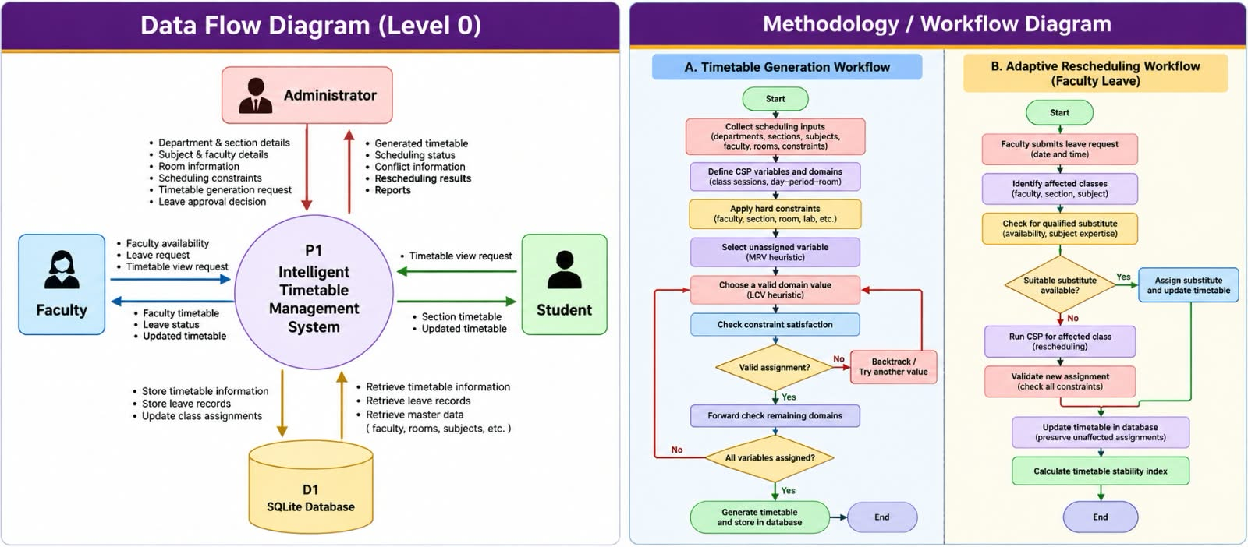
DFD Diagram

Slide 17
Methodology / Workflow Diagram

Slide 18
Tools and Technologies
Category | Technology | Purpose
Programming Language | Python | CSP implementation and backend logic
Web Framework | Flask | Web application and routing
Frontend | HTML, CSS,JavaScript | User interface and timetable display
Database | SQLite | Persistent storage of timetable data
AI Technique | CSP | Formal scheduling model
Search Algorithm | Backtracking Search | Assignment exploration
Heuristics | MRV and LCV | Variable and value ordering
Constraint Propagation | Forward Checking | Detect domain failures early
Development Environment | Visual Studio Code | Coding and debugging
Version Control | Git | Source-code management, if used
Testing | Application test cases | Validate generation and rescheduling behaviour

Slide 19
List of Modules
S. No. | Module | Function | Status
1 | University Data Management | Maintains university data, including departments, subjects, faculty, classrooms, and laboratories. | Completed
2 | CSP Formulation | Defines timetable variables, domains, and scheduling constraints. | Completed
3 | Constraint Validation | Checks faculty availability, room and section conflicts, laboratory requirements, and workload limits. | Completed
4 | Optimized Search | Applies Backtracking, MRV, LCV, and Forward Checking to generate feasible timetables. | Completed
5 | Adaptive Timetable Rescheduling | Handles faculty absences through substitution or rescheduling of affected classes while preserving unaffected assignments. | Completed

Slide 20
Module Implementation – Part 1
University Data Management Module
Implemented an SQLite database to maintain university information, including departments, subjects, faculty, classrooms, and laboratories.
Developed database operations to store, retrieve, and update the information required for scheduling.
The timetable generation process uses this stored data.
Output: Structured academic data supplied to the CSP formulation and scheduling modules.

Slide 21
Module Implementation – Part 1
2. CSP Formulation Module
Implemented the timetable scheduling problem using CSP model.
Variables: Individual class sessions that must be assigned to a timetable slot.
Domains: Available combinations of day, period, and room for each class session.
Constraints: Faculty availability, section and room conflicts, weekly workload limits, subject scheduling rules, and consecutive laboratory periods.
Converts the academic scheduling requirements into a structured problem that can be solved using search algorithms.
Output: A CSP model containing scheduling variables, domains, and constraints.

Slide 22
Module Implementation – Part 1
3. Constraint Validation Module
Implemented validation logic to check whether a proposed timetable assignment satisfies the scheduling rules.
Checks that a faculty member, classroom, or student section is not assigned to conflicting classes at the same time.
Verifies laboratory continuity, subject-period restrictions, faculty workload limits, and other configured constraints.
Invalid assignments are rejected during scheduling, preventing conflicts from being included in the final timetable.
Output: Valid assignments that satisfy the configured scheduling constraints.

Slide 23
Module Implementation – Part 2
4. Optimized Search Module
When an assignment violates a constraint or causes a future conflict, the algorithm reverses the assignment and explores another possibility.
Minimum Remaining Values (MRV): Selects the unassigned variable with the fewest remaining valid options.
Least Constraining Value (LCV): Prioritizes assignments that preserve more options for other unassigned classes.
Forward Checking: Updates the remaining domains after an assignment and detects impossible scheduling situations early.

Slide 24
Module Implementation – Part 2
5. Adaptive Timetable Rescheduling Module
When an absence is reported, the system identifies the affected class assignments in the existing timetable.
It first checks whether a qualified and available substitute faculty member can take the affected class.
If a suitable substitute is unavailable, CSP-based rescheduling searches for an alternative day and period while checking the relevant constraints.
The revised assignment is validated , saved to the database.
Output: An updated timetable with the affected, rescheduled, and unchanged assignments identified.

Slide 25
Preliminary Results and Discussion
Parameter | Configuration
Departments | 6
Sections per department | 2
Total sections | 12
Working days | Monday–Friday
Periods per day | 7
Duration per period | 50 minutes
Lunch break | 11:20 AM–12:20 PM
Laboratory duration | 2 consecutive periods

Slide 26
Preliminary Results and Discussion
Metric | Observed Result
Affected classes | 1
Rescheduled classes | 1
Classes covered by substitute | 0
Unchanged assignments | 365
Timetable stability | 99.73%

Slide 27
Preliminary Results and Discussion
Discussion
The system successfully demonstrated timetable generation and faculty-absence handling.
Adaptive rescheduling modified the affected assignment while preserving the remaining assignments in the observed test.
CSP constraints help prevent conflicts during timetable generation and rescheduling.
Further testing is required to evaluate execution time, search nodes, backtracking count, and performance across larger scheduling instances.

Slide 28
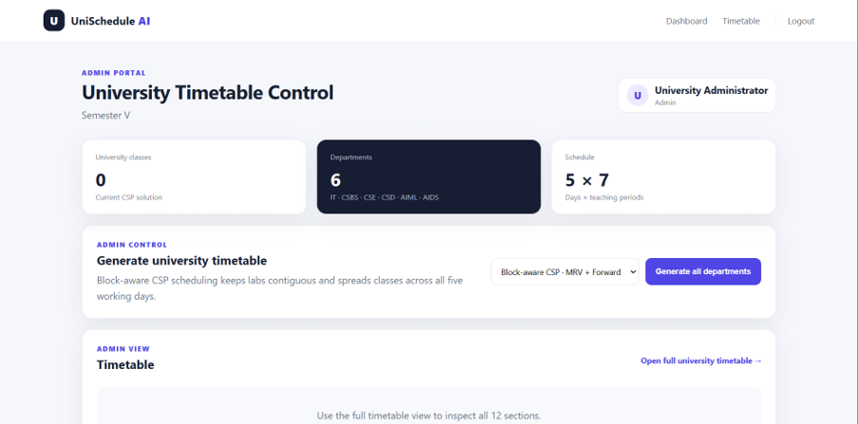
User Interface / Implementation Screenshots
Figure 1 - Administrator Dashboard

Slide 29
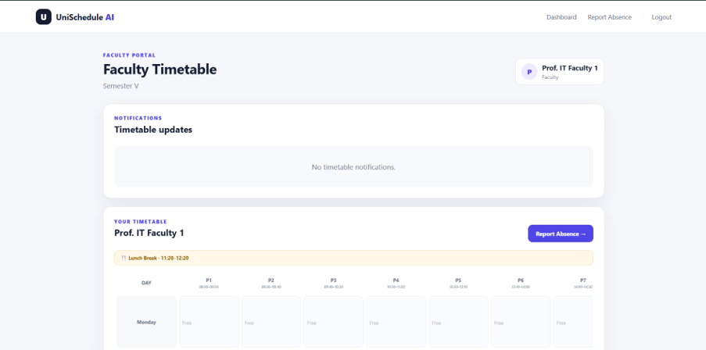
User Interface / Implementation Screenshots
Figure 2 – Faculty Dashboard

Slide 30
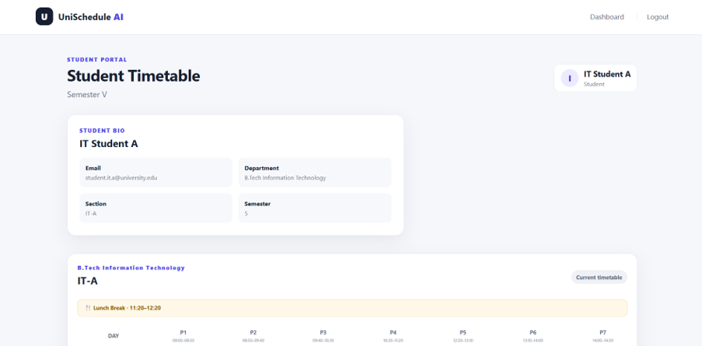
User Interface / Implementation Screenshots
Figure 3– Student Dashboard

Slide 31
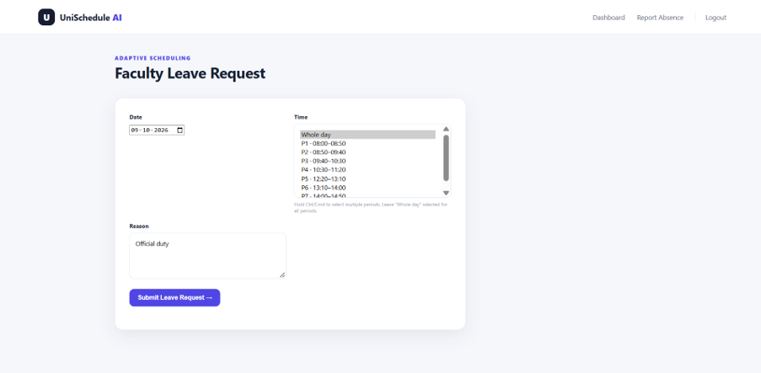
User Interface / Implementation Screenshots
Figure 4 - Faculty Absence Reporting Interface

Slide 32
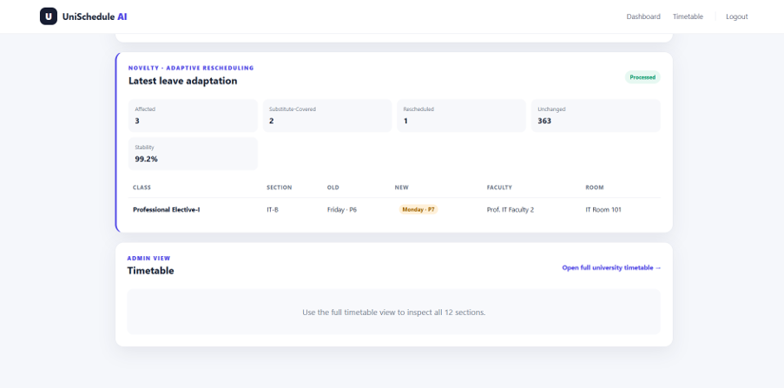
User Interface / Implementation Screenshots
Figure 5 - Admin Adaptive Rescheduling Result

Slide 33
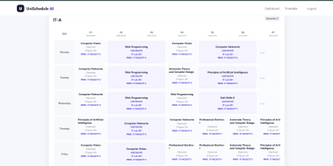
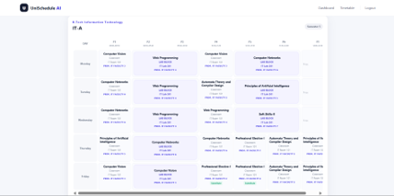
User Interface / Implementation Screenshots
Figure 6 & 7 - Before and After Timetable

Slide 34
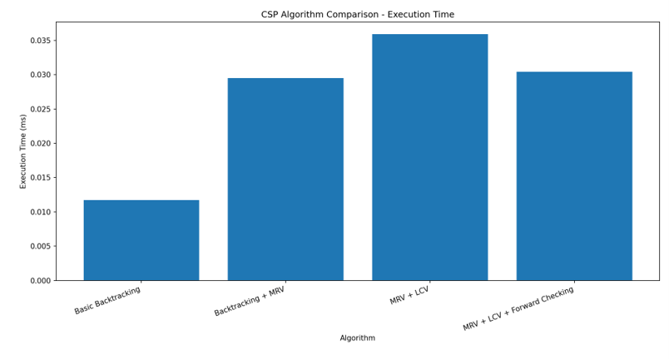
User Interface / Implementation Screenshots
Figure 8 – Comparison of execution time of various algorithms

Slide 35
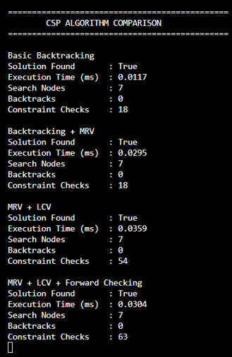
User Interface / Implementation Screenshots
Figure 9 - Comparison Statistics

Slide 36
Challenges Faced and Solutions
Challenge | Solution
Maintaining consecutive laboratory periods | Represented laboratories as two-period blocks
Faculty absence disrupting the timetable | Implemented substitute checking and adaptive rescheduling
Database locking during concurrent requests | Improved database connection handling and enabled appropriate SQLite configuration
Inconsistent rescheduling status in the interface | Updated timetable display conditions to distinguish rescheduled assignments from substitutions
Reliable performance comparison | Developed a separate CSP benchmark and identified the need for a conflict-rich test case

Slide 37
Challenges Faced and Solutions
Remaining Work
Complete and verify algorithm comparison experiments.
Validate additional timetable and rescheduling scenarios.
Review interface consistency.
Complete documentation and final testing.
Only retain the database-locking and interface issues if you want to discuss the actual development challenges you encountered.

Slide 38
Work Plan Until Final Review
Phase | Planned Work | Expected Outcome
Phase 1 | Complete algorithm comparison | Verified performance measurements
Phase 2 | Test faculty, room, section, and laboratory constraints | Constraint-validation report
Phase 3 | Test multiple leave and rescheduling scenarios | Verified adaptive behaviour
Phase 4 | Review timetable stability and unaffected assignments | Stability evaluation
Phase 5 | Fix remaining interface and database issues | Stable application
Phase 6 | Complete project documentation | Final report
Phase 7 | Prepare demonstration and presentation | Final review readiness

Slide 39
References
[1] Zhang, L., & Lau, S. K. (2005). Constructing university timetable using constraint satisfaction programming approach. Proceedings of the International Conference on Computational Intelligence for Modelling, Control and Automation, 2, 55–60. https://doi.org/10.1109/CIMCA.2005.1631445
[2] Abdelraouf, I., Abdennadher, S., & Gervet, C. (2011). A visual entity-relationship model for constraint-based university timetabling. arXiv. https://arxiv.org/abs/1109.6112
[3] Ceschia, M., Di Gaspero, T., Schaerf, A., & others. (2022). Educational timetabling: Problems, benchmarks and state-of-the-art results. Annals of Operations Research.

Slide 40
References
[4] Cheng, C., Kang, L., Leung, N., & White, G. M. (2005). Investigations of a constraint logic programming approach to university timetabling. Lecture Notes in Computer Science.
[5] Burke, E. K., Mareček, J., Parkes, A. J., & Rudová, H. (2009). Decomposition, reformulation, and diving in university course timetabling. Operations Research Proceedings. https://arxiv.org/abs/0903.1095

Slide 41
Thank You

